Slide 1
Linked list

Slide 2
Basics
Dynamic memory allocation
  new and delete

Slide 4
Basics
Structures
  ‘ . ’ operator
  -> operator

Slide 5
Linked List

Slide 8
Traversing a Link List

Slide 9
Adding to the end of Link List

Slide 10
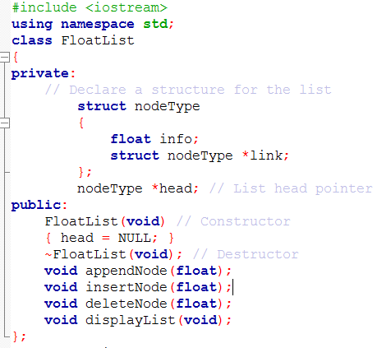
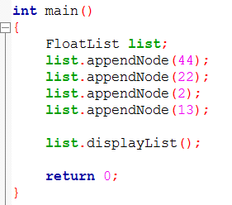
Link List class for storing float values

Slide 11
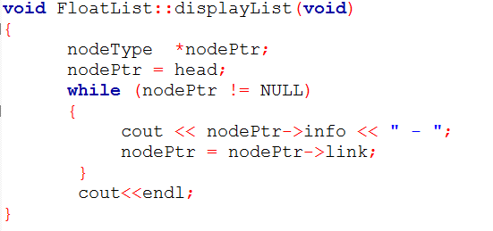

Slide 12
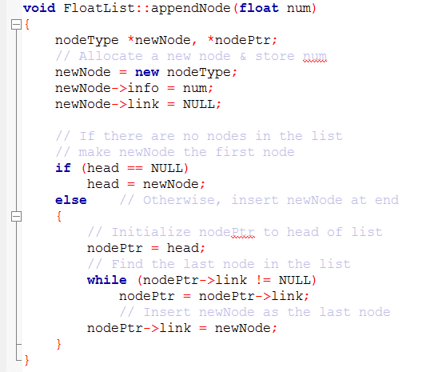

Slide 13


Inserting a Node in the middle
Assume, we want to insert a value of 50 between 65 and 34

Slide 14
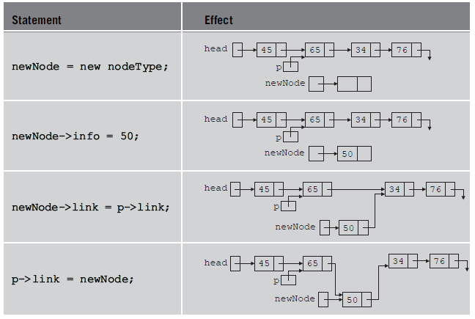

Slide 15
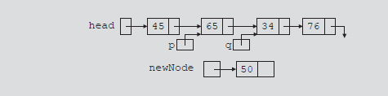
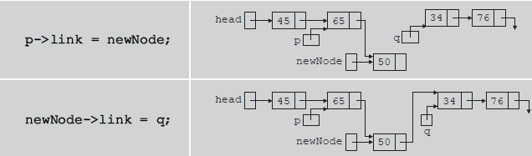
Another approach for insertion

Slide 16
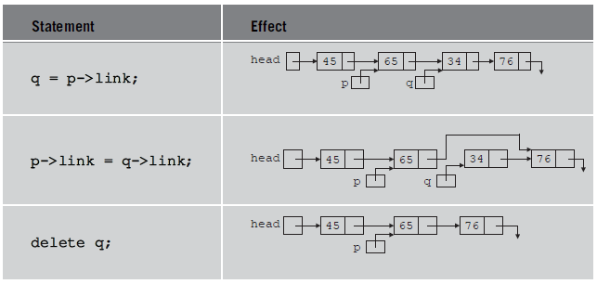
Deleting a Node
Assume, we want to delete a node with value of 34

Slide 17
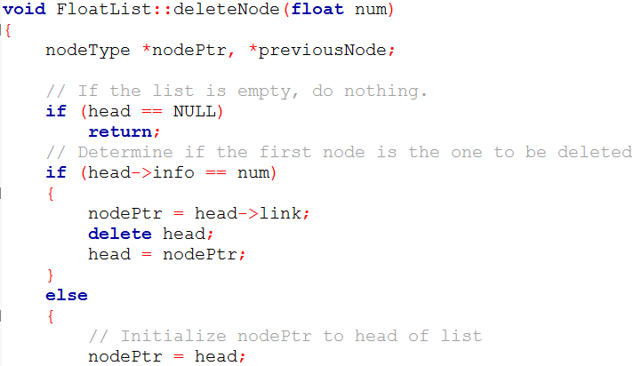
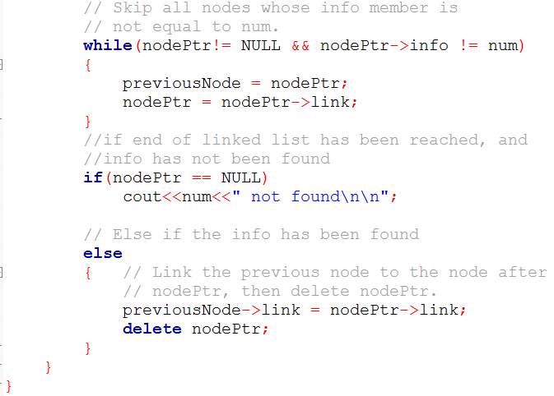

Slide 18
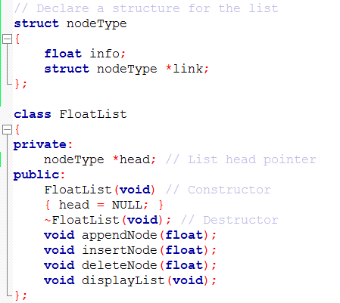

Slide 19
Linked list
Handling dynamic Memory
Destructor
Assignment operator
copy constructor

Slide 20
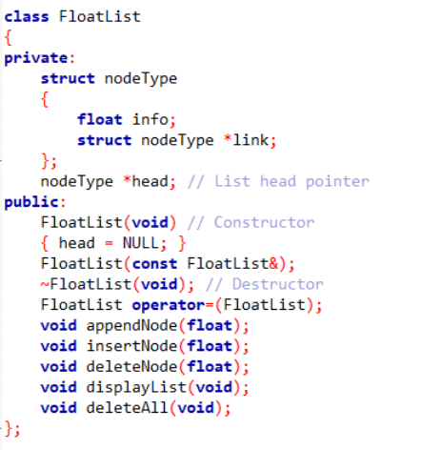
Link List class Updated now

Slide 21
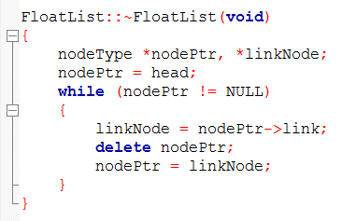
Destructor

Slide 22
Assignment Operation
FloatList list1, list2;
list1.append(20);
list1.append(45);
list1.append(51);
list1.append(76);
list2=list1;
list1
header
20
45
51
76
NULL
list2
header

Slide 23


Assignment Operator Overloading for FloatList class
A
header
20
45
51
76
NULL
B
header
20
45
51
76
NULL
A
header
20
45
51
76
NULL
B
header

Slide 24
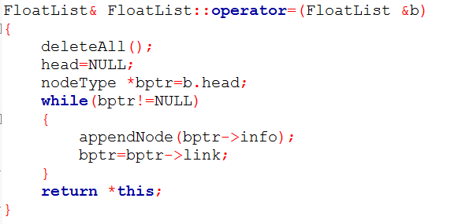
Assignment Operator Overloading

Slide 25
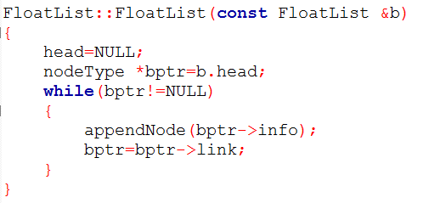
Copy Constructor
The copy constructor is a constructor which creates an object by initializing it with an object of the same class, which has been created previously

Slide 26
Copy Constructor
A class with dynamic memory allocation also needs a copy constructor in scenarios, where a class object has to be used as a parameter in some function.
The copy constructor automatically executes in three situations:
  When an object is declared and initialized by using the value of another object
  When, as a parameter, an object is passed by value

Slide 27

New object creation using existing object
FloatList listA;
//assuming list has been populated with some values
FloatList listB( listA );
//this is a call to a copy constructor, which should populate listB with same values as of listA

Slide 28
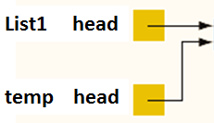
2. floatList object passed as value
  FloatList list1;
  //assuming list1 have some values
  xFunc(list1);
If copy const is not defined, then default member wise copy will take place, temp head will get list1 head address, thus rather having its own nodes, temp will point to the nodes of list1.
void xFunc(FloatList temp) {
. . . .
}

Slide 29

Template Link List class
FloatList class can be used create a link list of only float values
If link list is required for storing other data types as well, then either
  as many link list classes needs to be defined, as many data types we want to store in the link lists OR
  make a template link list, which will serve all the data types

Slide 30
Template Link List
The template link list can be used to create link list for
  Basic data types, e.g., int, char, float etc
  User defined classes
For user defined classes to be used with template link list, we may need to overload some operators
  cout<<class_object in display
  May be == , != in deletion

Slide 31
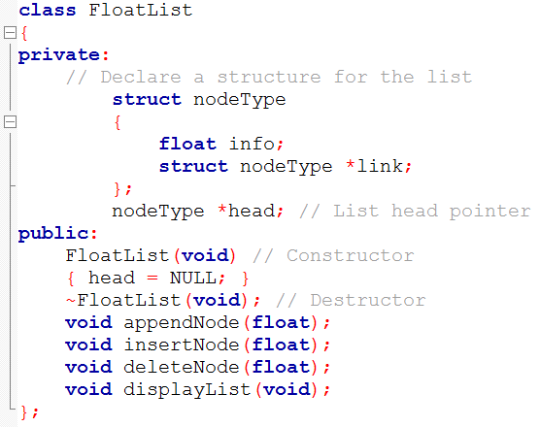


Link List

Slide 32
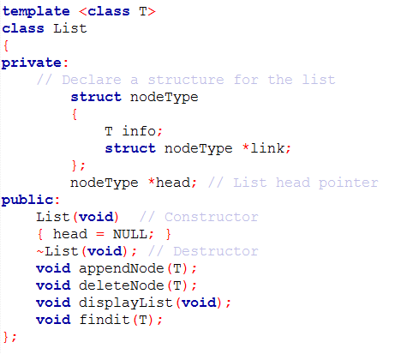
Template link list

Slide 33

template line
If class member functions are defined outside of class, then every function will also have the template line

Slide 34

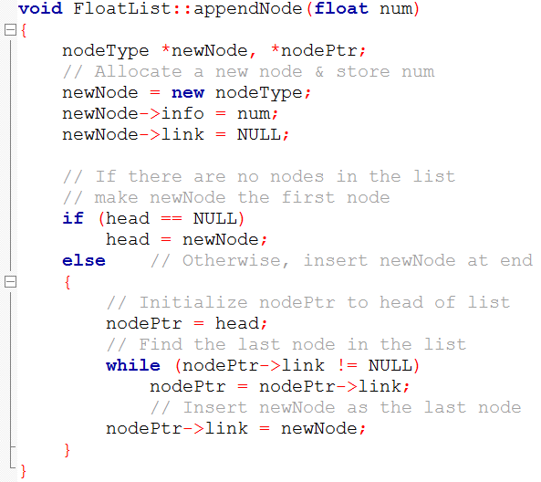

Slide 35
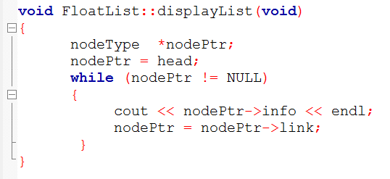

Slide 36

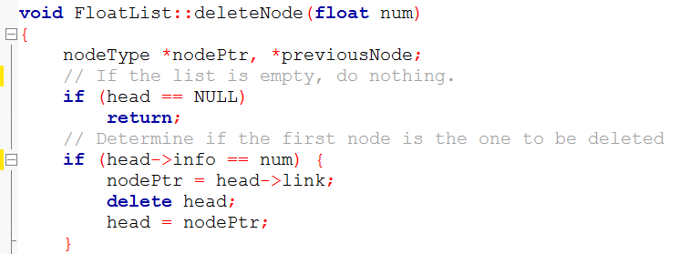
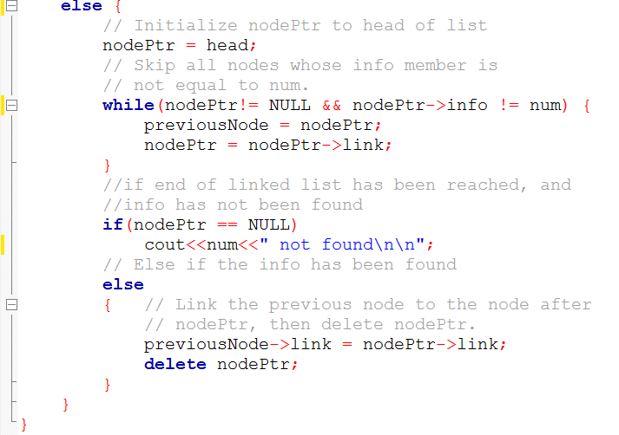

Slide 37
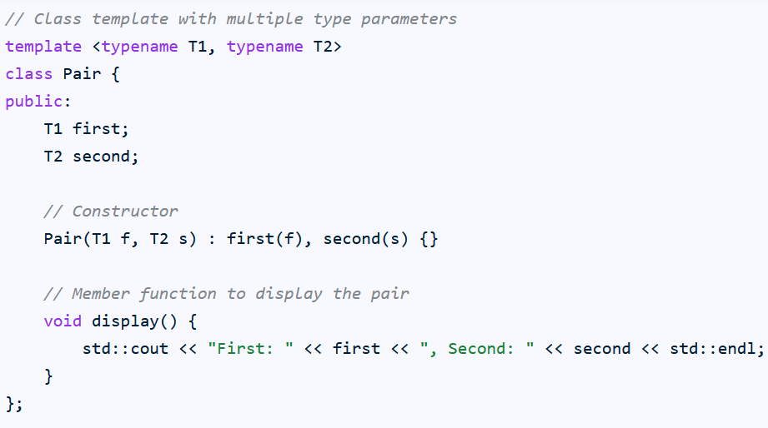
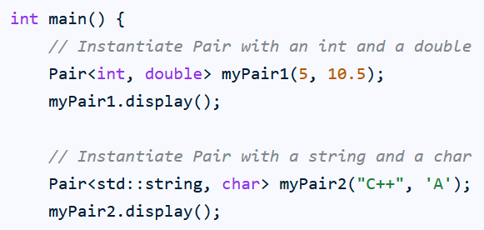
Multiple template parameters

Slide 38
Template link list
Suppose we have a class Distance
class Distance {
int feet;
int inches;
}
What if we want to have a link list of Distance class.

Slide 39
Template Link List
If we are using template link list to store class objects, then some operators may need to be overloaded, e.g.,
<< operator
  In displayList function, to print the data of class object

